Slide 1
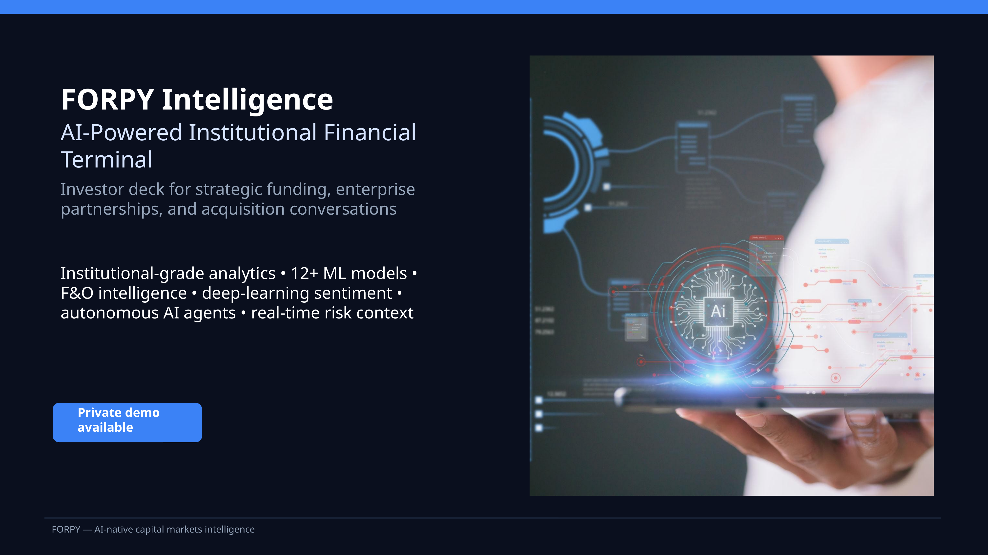

Slide 2
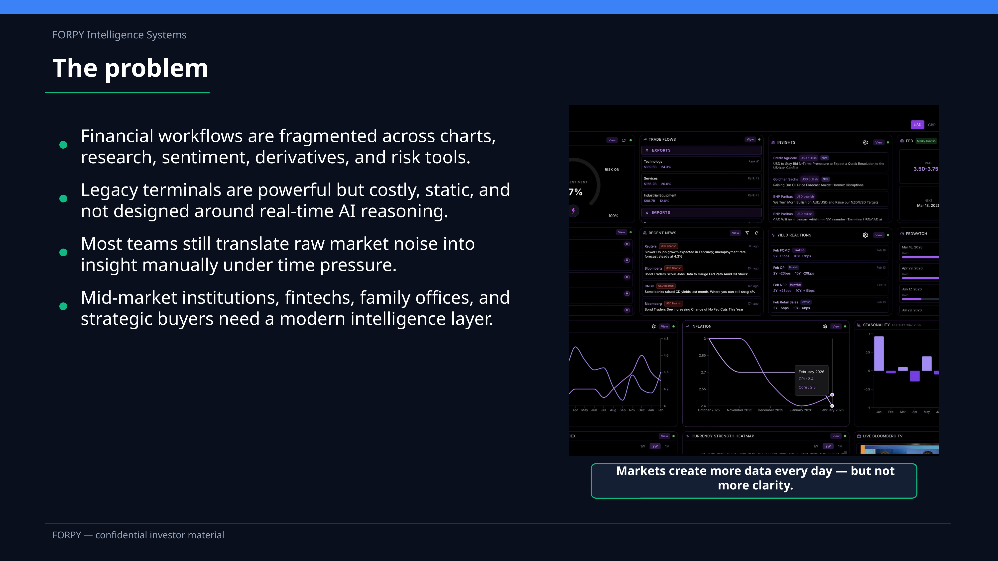

Slide 3
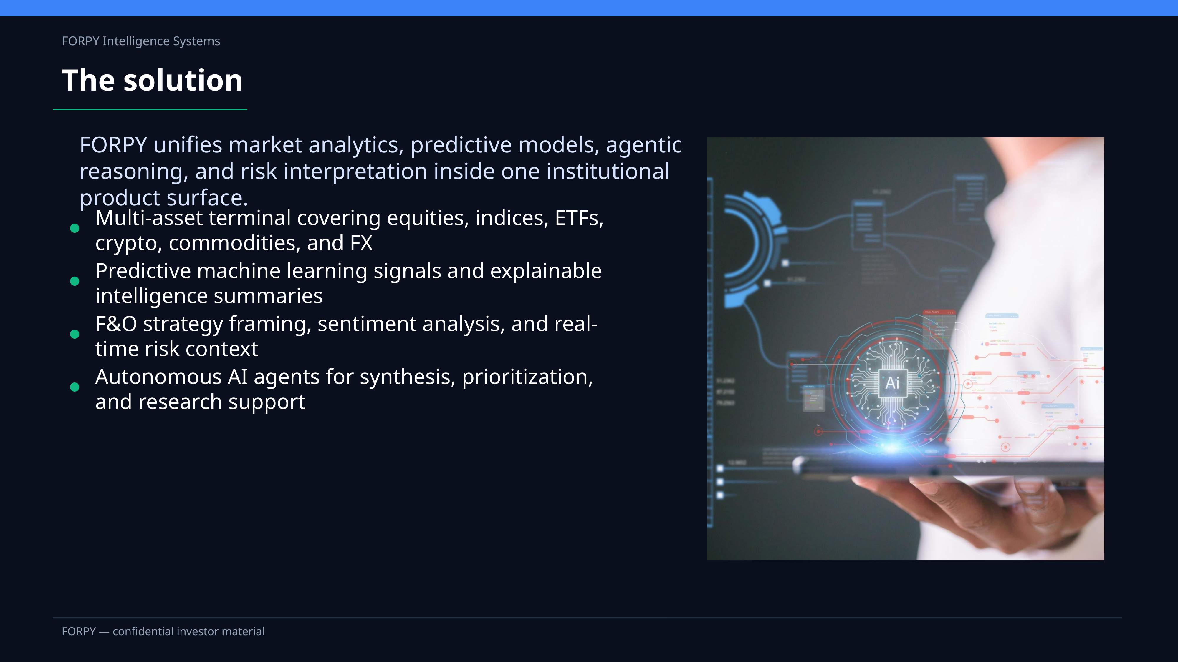

Slide 4
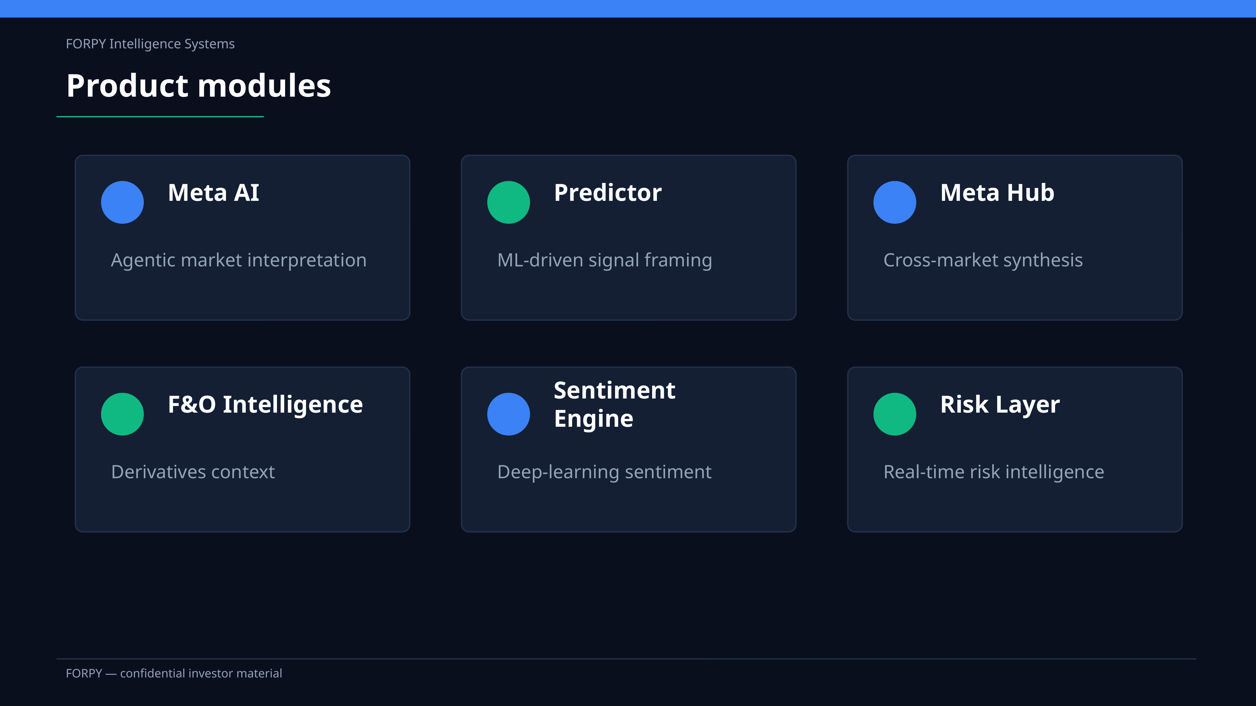

Slide 5
FORPY Intelligence Systems
ML module in action
Signals, simulation, scenarios, and portfolio construction are unified into one institutional ML workflow.
Signal engine
Return simulator
Apex forecaster
Directional bias, expected move, confidence, and model agreement for live signal framing.
Buy-and-hold, SPY benchmark, ML timing, drawdown, volatility, and watchlist comparison.
Single-stock and watchlist bull, base, and bear scenarios with projected alpha vs benchmark.
Strategy builder
Model stack
Portfolio intelligence
Corpus amount, horizon, risk profile, max weights, and action-oriented allocation guidance.
RF, LSTM, GRU, Transformer, XGBoost, LightGBM, CatBoost, CNN-LSTM, and ensemble workflows.
Watchlists become concentration, overlap, hedge, trim-before-add, and rebalance intelligence.
FORPY — confidential investor material

Slide 6
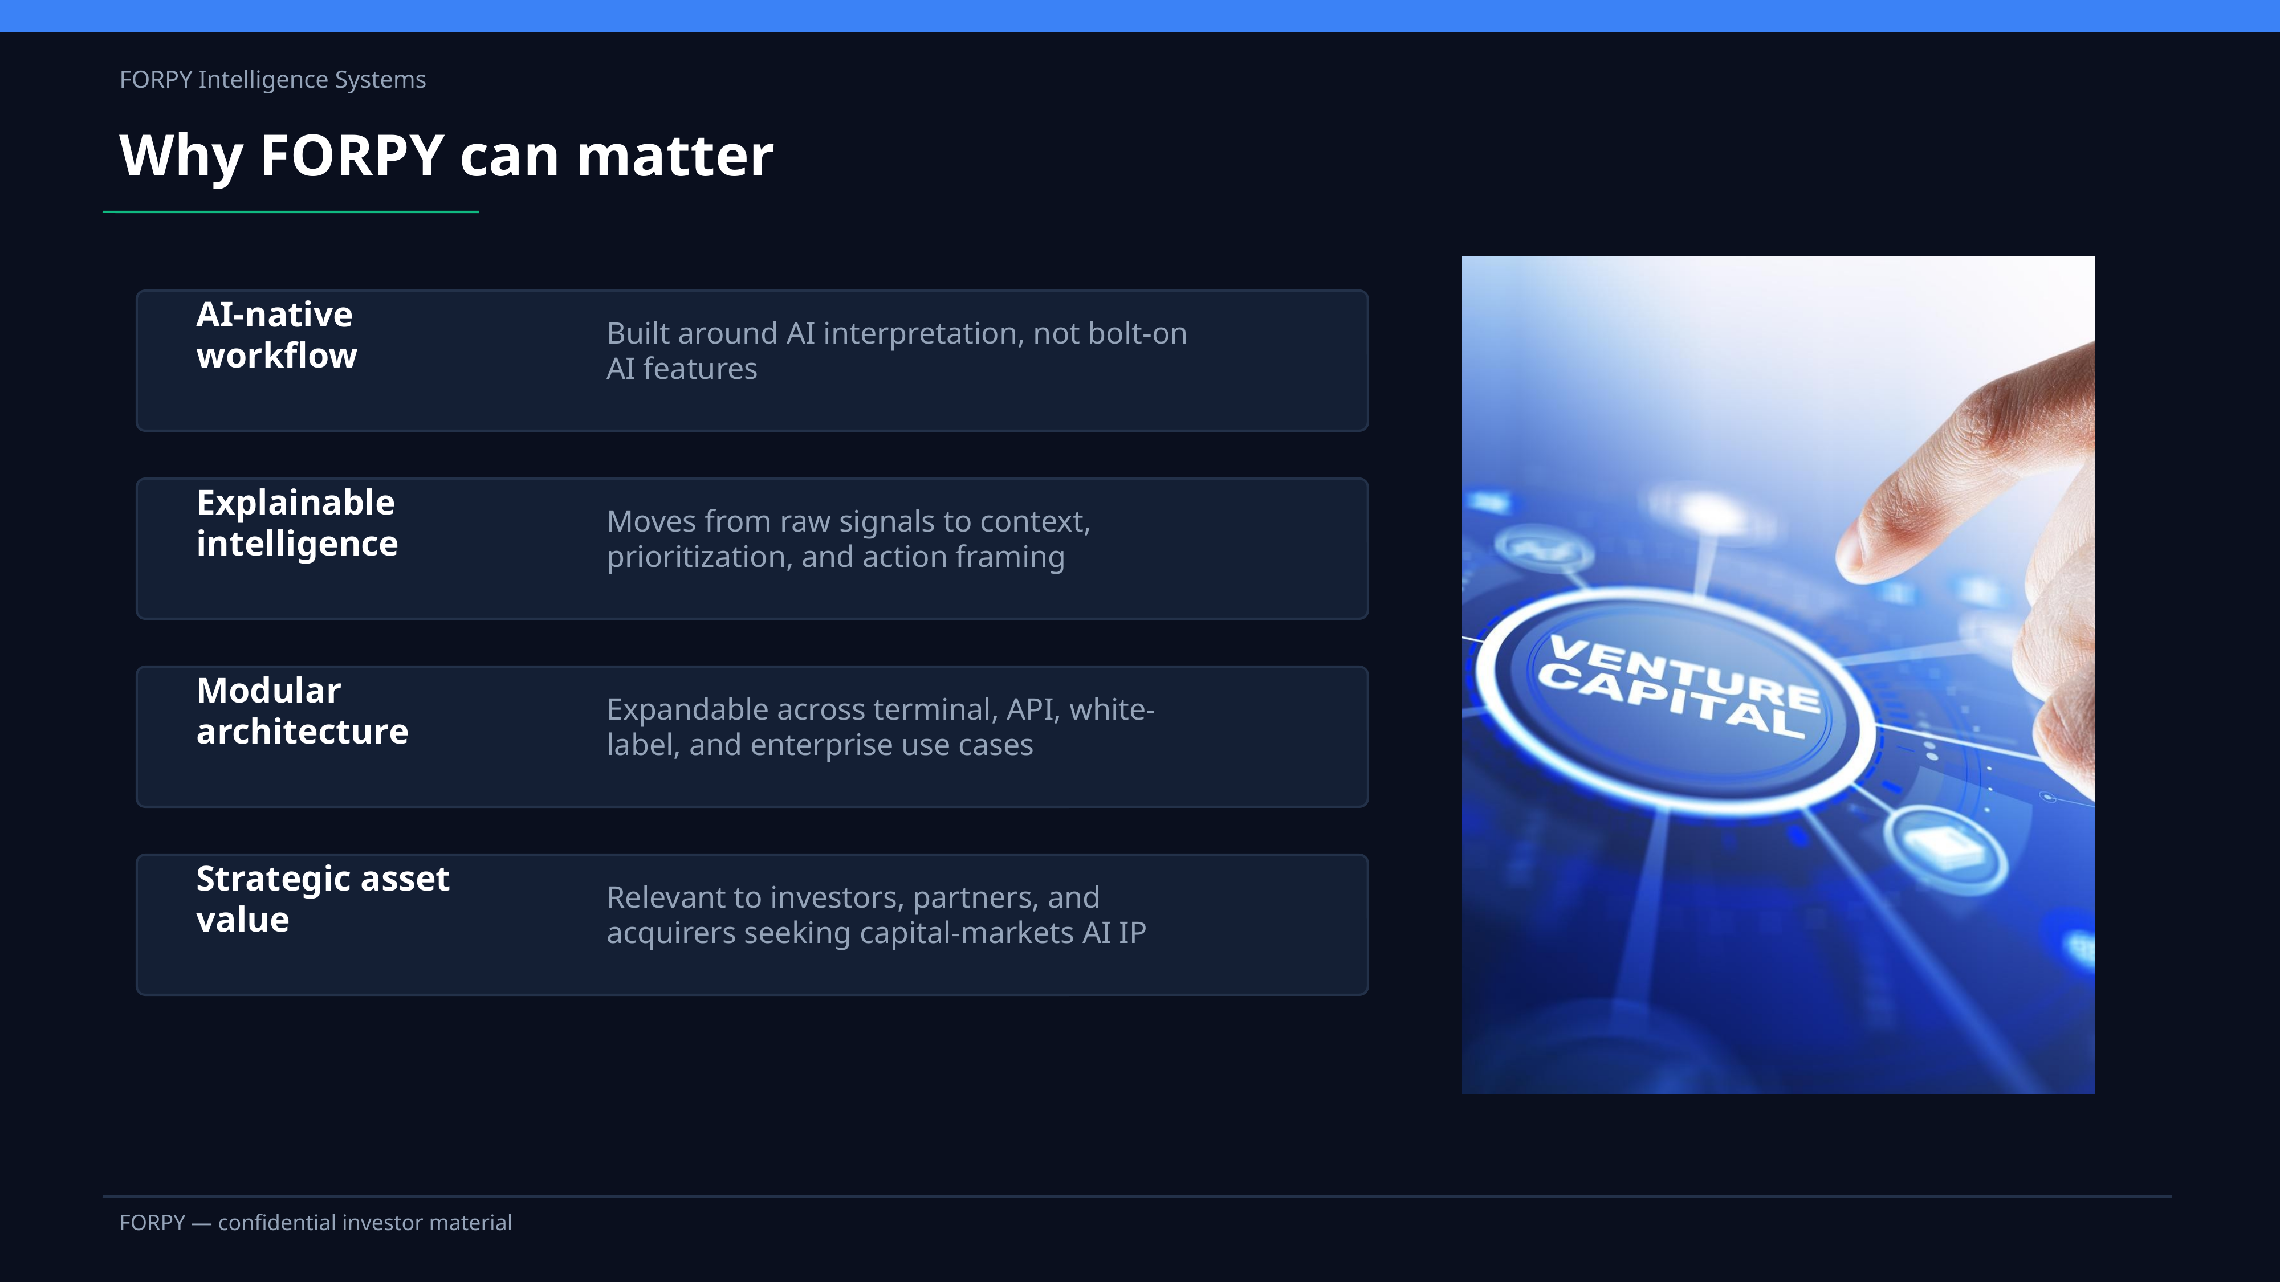

Slide 7
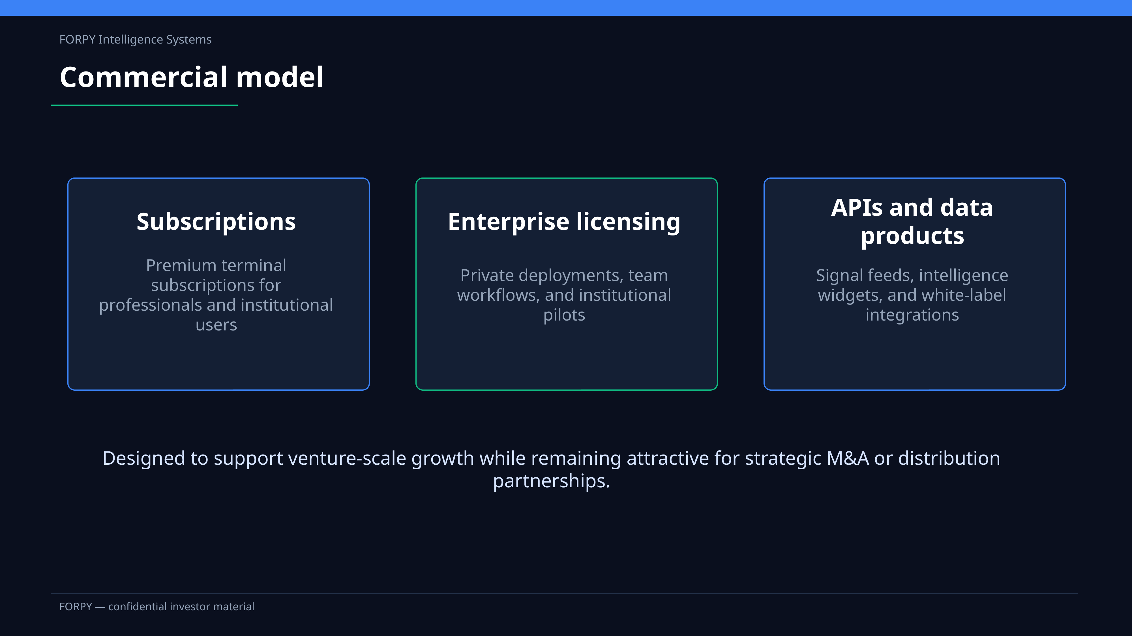

Slide 8
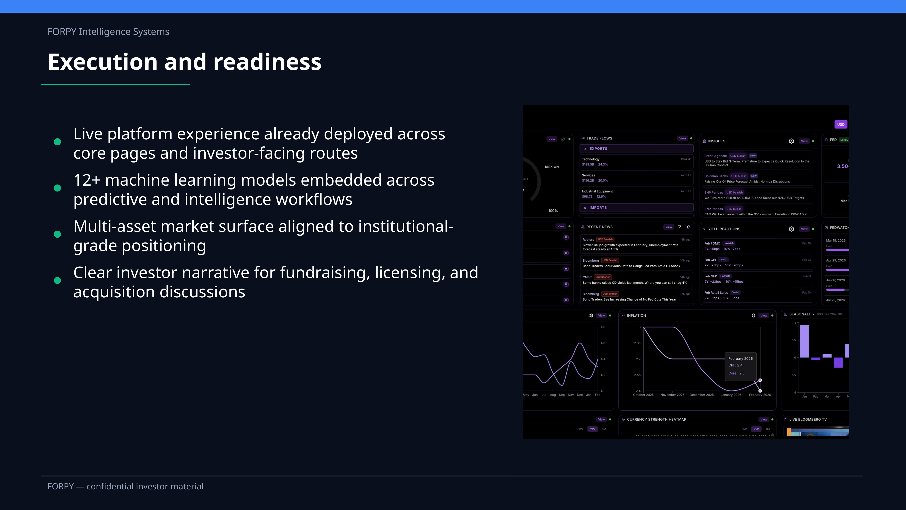

Slide 9
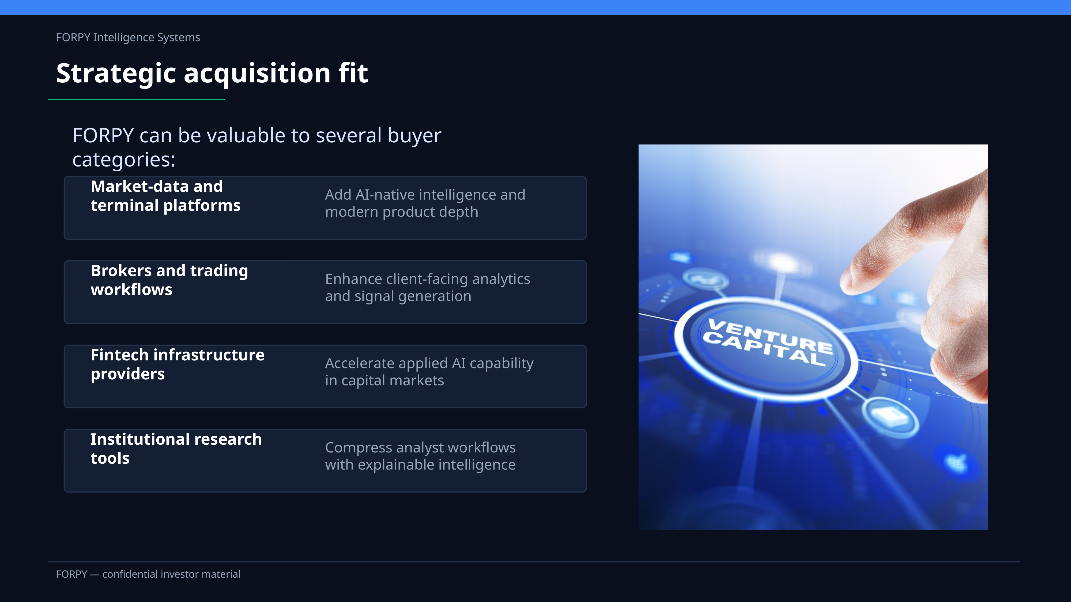

Slide 10
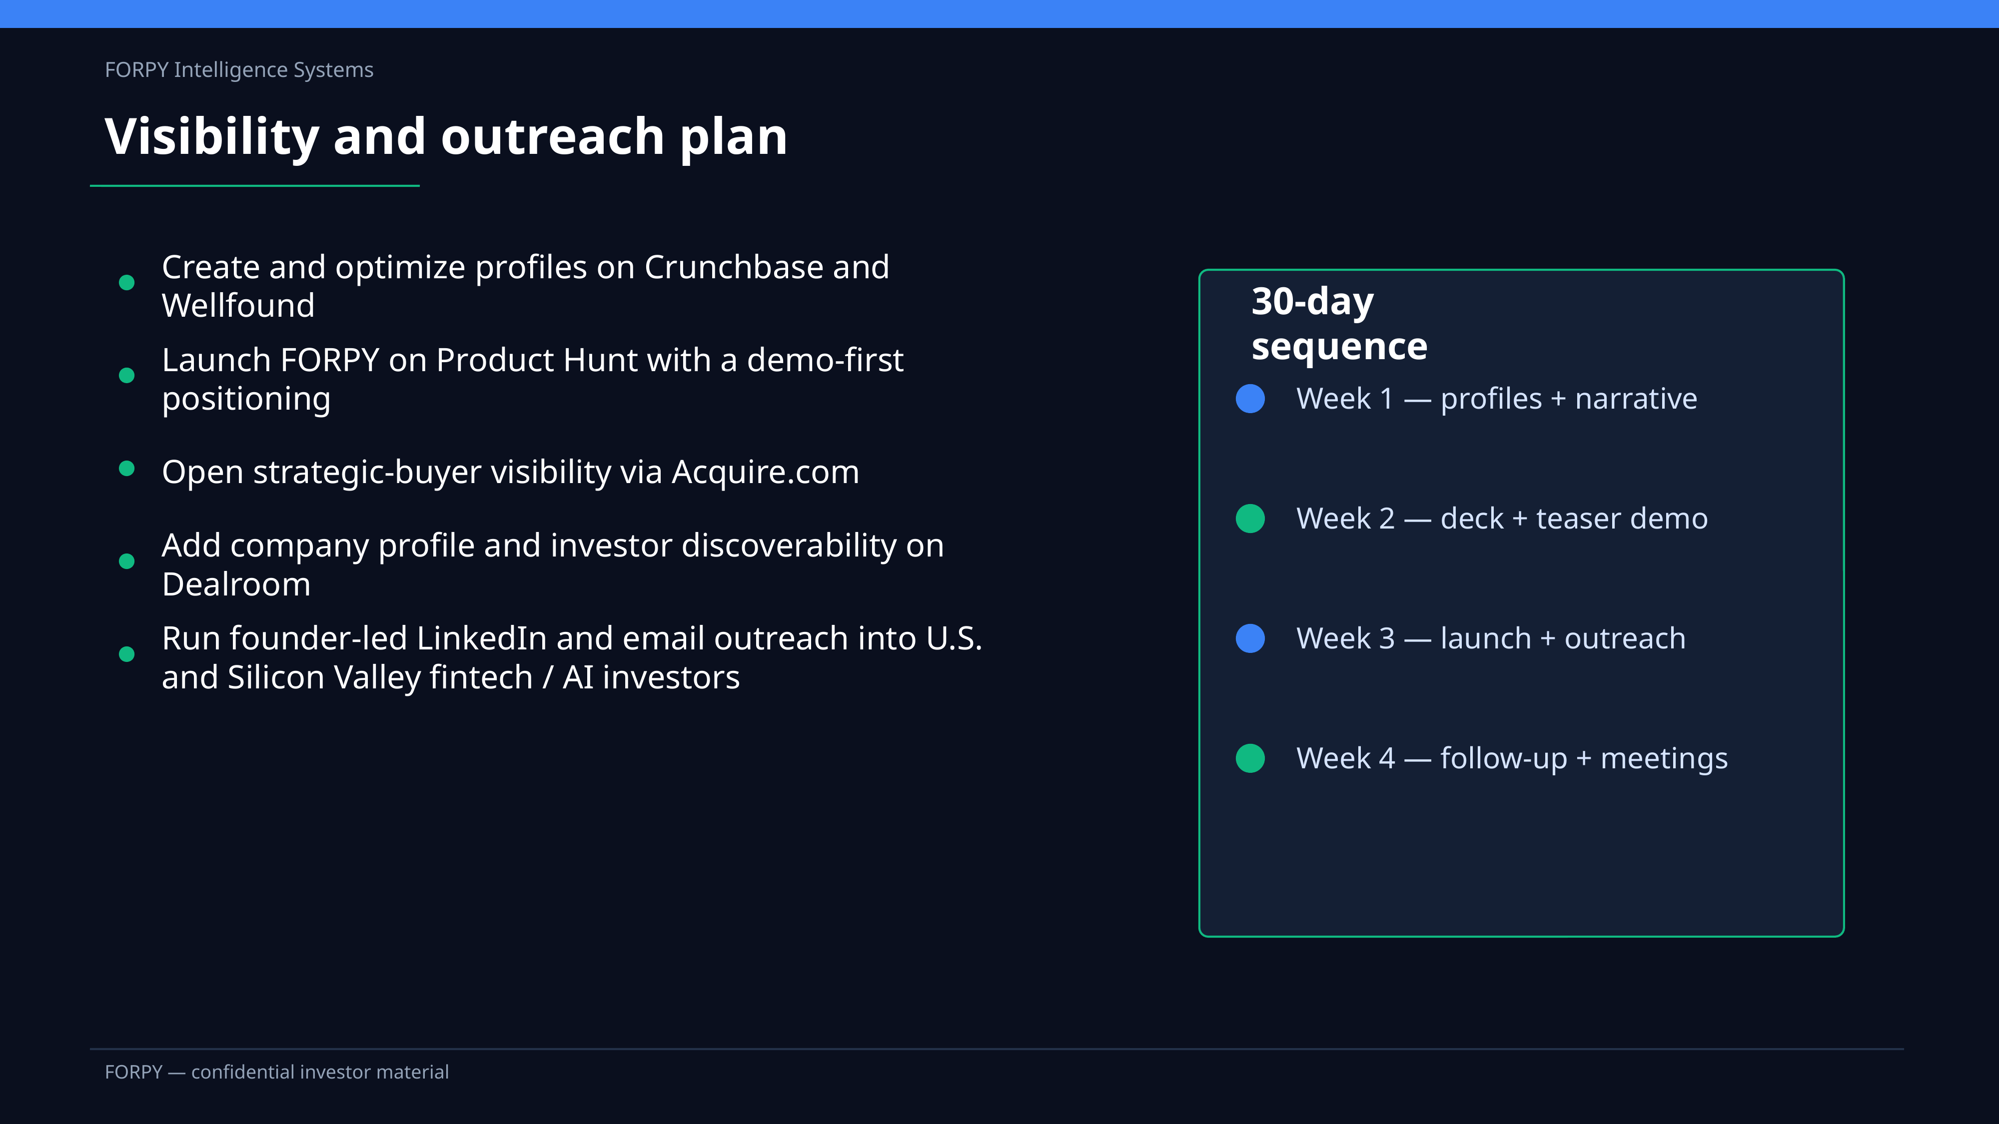

Slide 11
